Slide 1
Lab 3
Constructors, Destructors
and the Copy That Crashes
Object Oriented Programming Sessional
Department of Computer Science & Engineering
Bangladesh Army University of Science & Technology, Khulna

Slide 2
LAST LAB
Where we left off
You wrote a full class with private data and public functions.
You used static members to count objects and generate IDs automatically.
But you still had to call setData() by hand after creating every object.
Today that stops. Objects will initialise themselves.
OOP Sessional · Lab 3 · BAUST Khulna
2

Slide 3
TODAY · 3 HOURS
The plan
A
35 min
Constructors
default, one-argument, three-argument, and a trap
B
35 min
Destructors
predict the order, then check your prediction
C
50 min
Shallow vs deep copy
make the program crash, then fix it
D
50 min
Exercise
a Message class that survives being copied
OOP Sessional · Lab 3 · BAUST Khulna
3

Slide 4
PART A
Constructors
A function that runs by itself when an object is created.

Slide 5
PART A
Three constructors, one class
class Student
{
int roll; string name; double marks;
public:
Student() { /* defaults */ }
Student(int r) { /* roll only */ }
Student(int r, string n, double m) { /* all */ }
};
Student a; // first
Student b(101); // second
Student c(102, "Karim", 85.5); // third
OOP Sessional · Lab 3 · BAUST Khulna
5

Slide 6
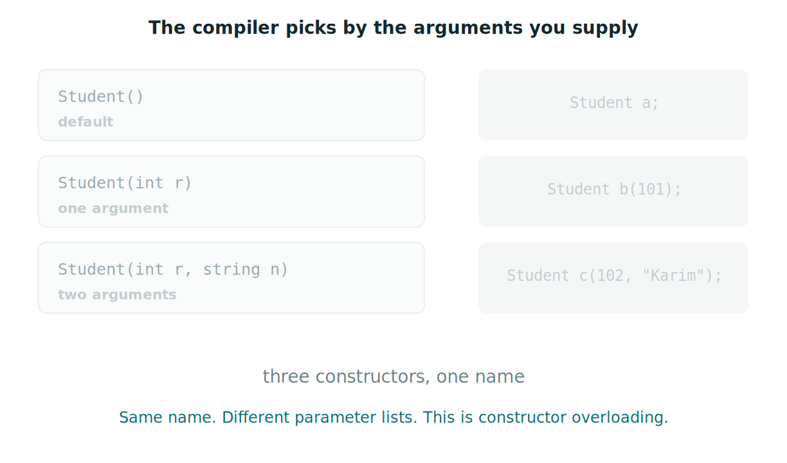
PART A
How the compiler chooses
OOP Sessional · Lab 3 · BAUST Khulna
6
Notes:
Animated GIF - plays in Slide Show mode (F5).

Slide 7
PART A · EXPERIMENT
The trap everyone falls into once
Student e();
e.display();
Compile this. Write down the exact error.
The compiler reads Student e(); as a FUNCTION declaration, not an object.
When there are no arguments, leave the brackets off entirely: Student e;
OOP Sessional · Lab 3 · BAUST Khulna
7

Slide 8
PART B
Destructors
Predict the output before you run it. Then compare.

Slide 9
PART B
Write your prediction first
int main()
{
Marker a("a");
Marker b("b");
{
Marker c("c");
}
insideFunction();
return 0;
}
On paper, before you compile:
In what ORDER do the constructor and destructor messages appear?
Where exactly does c die?
Your prediction goes in the lab report, right or wrong. That is the point of it.
OOP Sessional · Lab 3 · BAUST Khulna
9

Slide 10
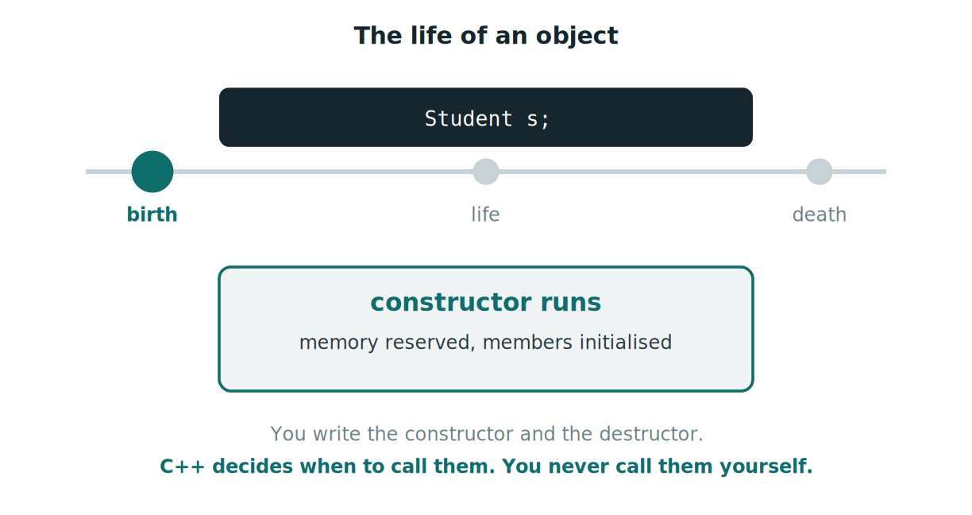
PART B
The life of an object
OOP Sessional · Lab 3 · BAUST Khulna
10
Notes:
Animated GIF - plays in Slide Show mode (F5).

Slide 11
PART C
Shallow vs deep copy
The most important half hour of the semester so far.

Slide 12
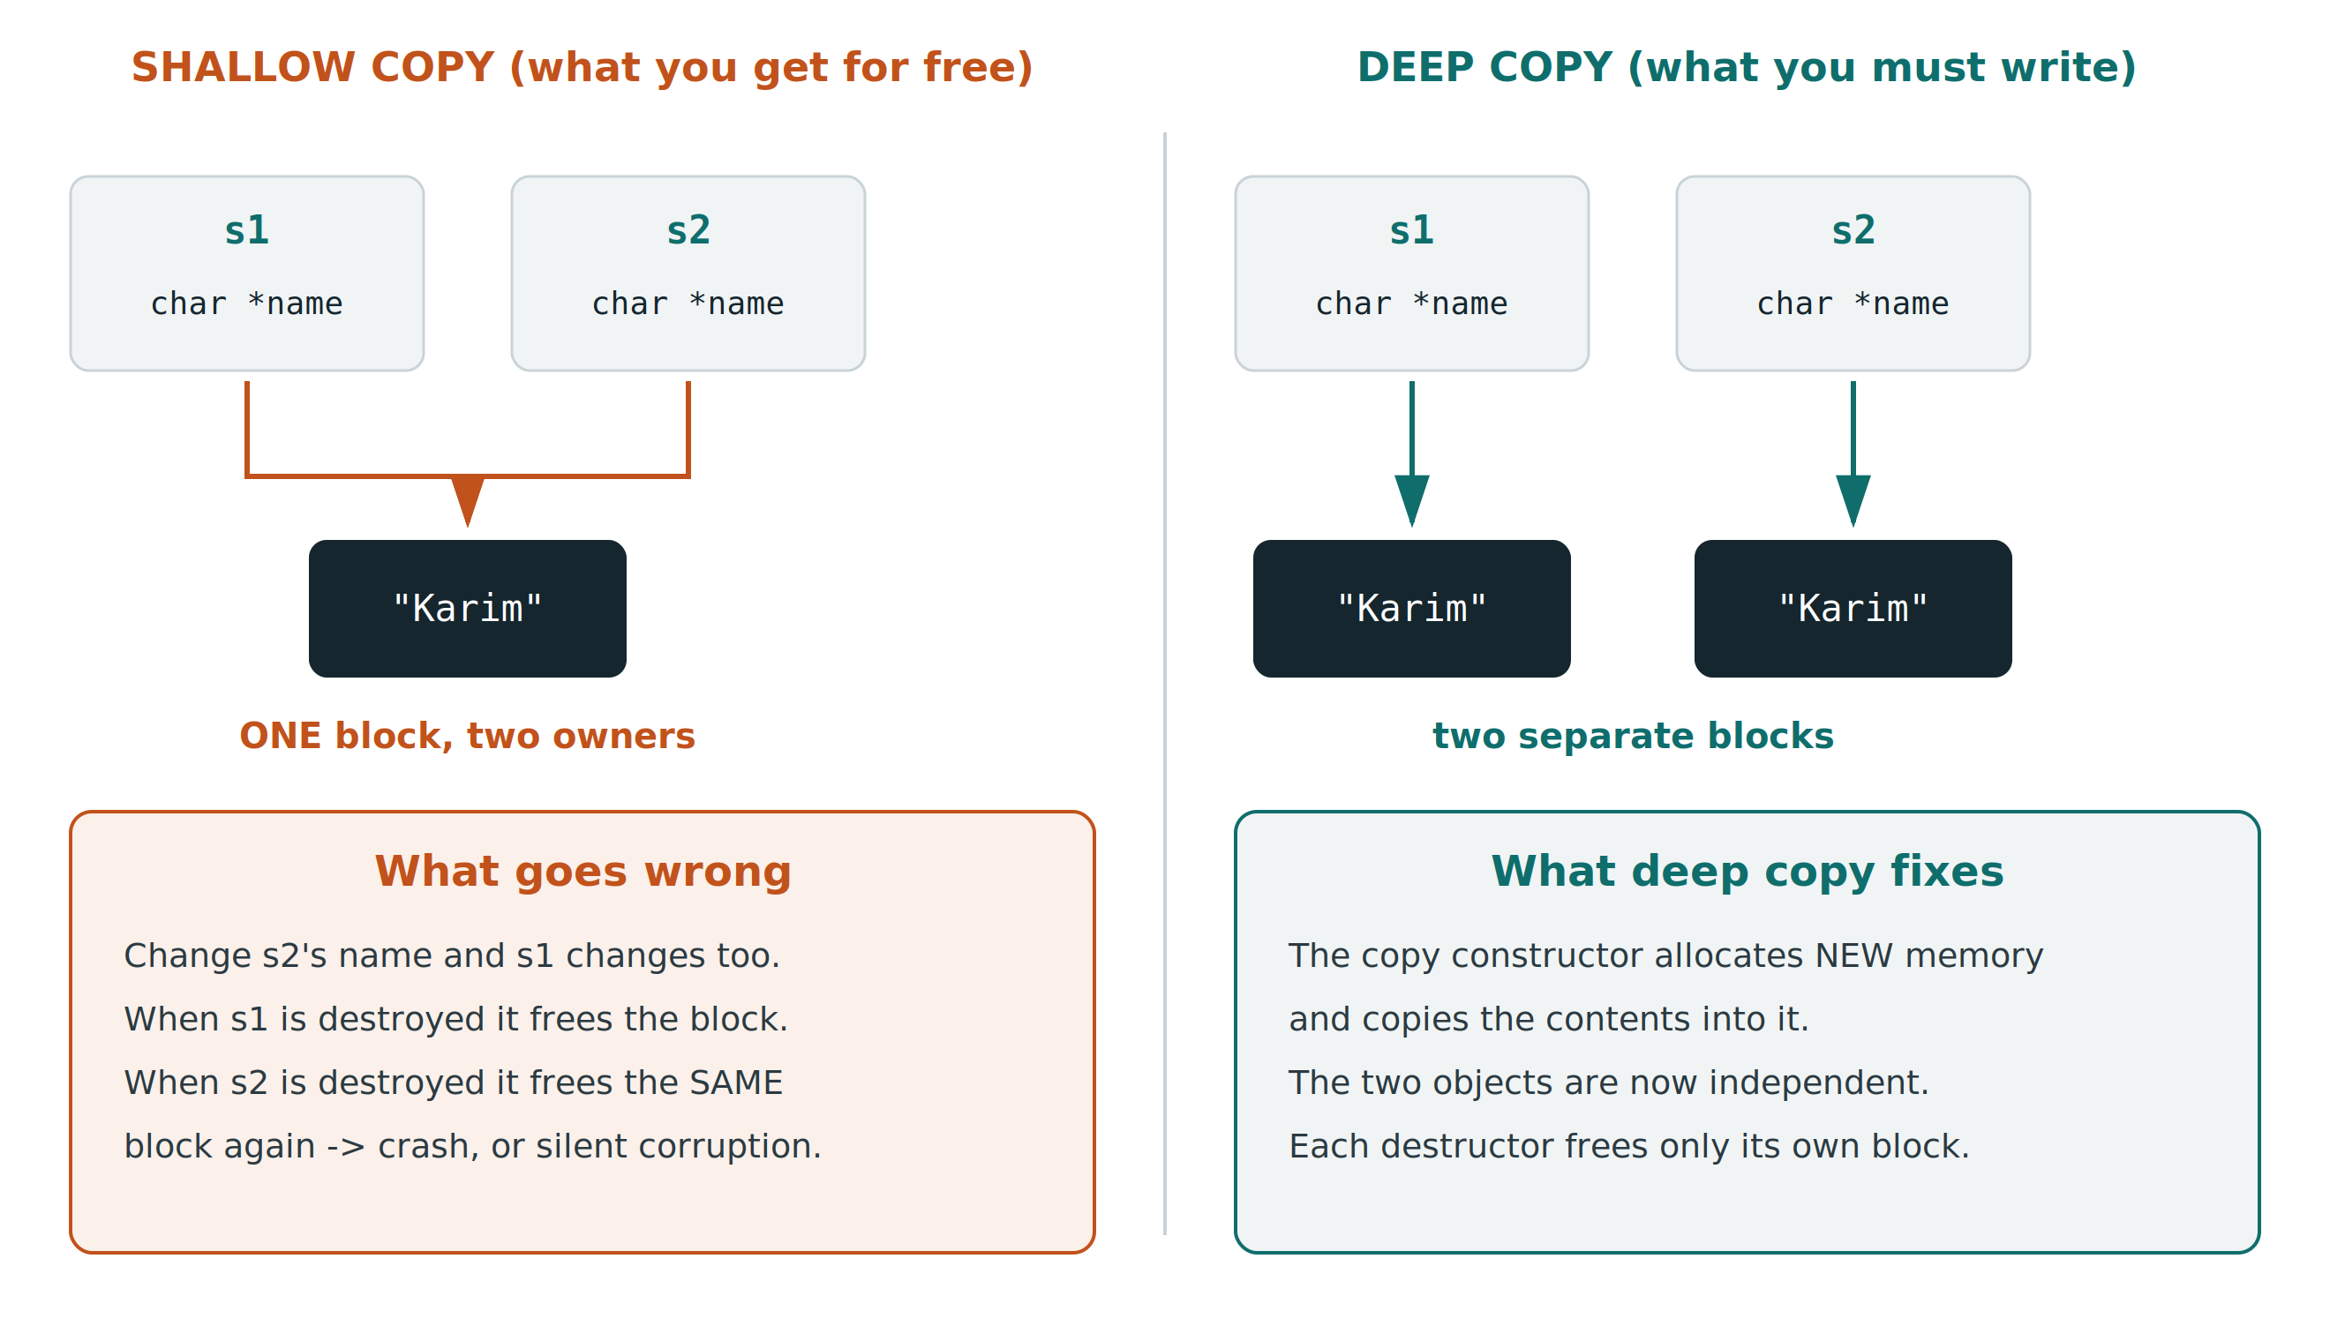
PART C
One block, or two?
OOP Sessional · Lab 3 · BAUST Khulna
12

Slide 13
PART C · STEP 1
Make it crash
class Name
{
private:
char *text;
public:
// constructor - allocates its own memory
Name(const char *n)
{
text = new char[strlen(n) + 1];
strcpy(text, n);
cout << " constructor : " << text
<< " at address " << (void*)text << "\n";
}
void change(const char *n)
{
strcpy(text, n);
}
void display()
{
cout << " " << text
<< " at address " << (void*)text << "\n";
}
~Name()
{
cout << " destructor : freeing " << (void*)text << "\n";
delete[] text;
}
OOP Sessional · Lab 3 · BAUST Khulna
13

Slide 14
PART C · STEP 1
Make it crash
int main()
{
Name a("Karim");
Name b(a); // copy constructor runs here
cout << "\n after copying:\n";
a.display();
b.display();
b.change("Rahim");
cout << "\n after changing only b:\n";
a.display();
b.display();
cout << "\n now both objects are destroyed:\n";
return 0;
}
constructor : Karim at address 0x5575...2b0
after copying:
Karim at address 0x5575...2b0
Karim at address 0x5575...2b0 <- SAME address
destructor : freeing 0x5575...2b0
destructor : freeing 0x5575...2b0 <- again!
free(): double free detected in tcache 2
Aborted
OOP Sessional · Lab 3 · BAUST Khulna
13

Slide 15
PART C · STEP 2
Three things to notice
Only ONE constructor message appeared, but TWO destructor messages did.
Both objects printed the SAME address. They share one block of memory.
Changing b changed a as well, because there is only one block to change.
The crash happened at the END of the program, far from the line that caused it.
This is why a bug like this is so hard to find in a real program.
OOP Sessional · Lab 3 · BAUST Khulna
14

Slide 16
PART C · STEP 3
Now fix it
Name(const Name &other) // deep copy constructor
{
text = new char[strlen(other.text) + 1]; // NEW memory
strcpy(text, other.text); // copy contents
}
Two different addresses now. Two constructors, two destructors, no crash.
OOP Sessional · Lab 3 · BAUST Khulna
15

Slide 17
PART D · 50 MINUTES
The exercise
Write a class Message that stores text in char *body using new.
A constructor that allocates memory and copies the text in.
A DEEP copy constructor.
A destructor that frees the memory with delete[].
edit(text) that replaces the stored text — careful, the new text may be LONGER.
display() that prints the text and its address.
In main(): create m1, copy it into m2, edit m2, and show m1 is unchanged.
Count your constructor and destructor messages. They must match exactly.
OOP Sessional · Lab 3 · BAUST Khulna
16

Slide 18
BEFORE YOU LEAVE
Lab report
All four programs. Your WRITTEN PREDICTION for Part B next to the real output.
The crash output from Part C, and the fixed output beside it.
HOMEWORK · DUE NEXT LAB
Take your BankAccount class from Lab 2 and give it constructors.
A default constructor and a parameterised one. Delete openAccount() entirely — the constructor replaces it. Add a destructor that prints which account is closing, and show that accounts close in reverse order.
Next lab: friend functions, and objects passed to functions.

